Slide 1

Reserve Bank of India

Slide 2


Functions of Reserve Bank of India
Reserve Bank as Note-Issuing Authority
One Rupee notes and coins were issued by the Government of India
Bank Notes were issued by RBI
RBI has the sole right to issue bank notes in India.
Issue of Notes and general banking business is undertaken by two departments :
Issue Department
Banking Department

Slide 3


The assets of the Issue Department against bank notes are as follows:-
Gold Coins and Bullion
Foreign Securities
Rupee coins
Government of India rupee securities
Bill of Exchange and Promissory Notes

Slide 4

Currency Chests
It is the boxes or containers in which stocks of new or re issuable notes are stored along with rupee coins. It is maintained by RBI, State Bank and its subsidiaries, public sector banks, Government treasuries.
Advantages:
Payment of the bank exceed, immediately withdraw funds
Funds are surplus, deposit the amount in it to.
Exchange of rupee coins for notes
Issue of new notes for old and soiled ones

Slide 5

2. Reserve Bank as Banker to Government
It act as banker to the central and state governments.
Issue of new loans on behalf of Government
Auctions for the treasury bills and government dated securities
Appoint SBI as its sole agent
Act as adviser to the government on important economic and financial matters

Slide 6

3. Reserve Bank as Banker’s Bank
It is the banker to all banks included in scheduled banks.
It must be:-
A state co-operative bank
A company registered under Companies Act 1956
An Institution notified by Central Government
A corporation incorporated outside India

Slide 7

Minimum value of paid-up capital and Reserves
  Not less than 5 lakhs
  Total realizable value of the assets minus outside liabilities equal to or more than 5 lakh rupees.
  Depositors Interests
  Soundness
  Solvency
  Interest of the depositors

Slide 8

4. Reserve Bank as Lender of the Last Resort
a) Rediscounting of Bills
Commercial Bills – Drawn and payable only in India and mature within 90 days
Bill for Financing Agricultural operations – Marketing of crops and mature within 15 months
Bill for Financing Cottage and Small-Scale Industries – Mature within 12 months
Bill for Holding or Trading in Government Securities - Mature within 90 days
Foreign Bills – Export of goods from India and mature within 180 days

Slide 9

b) Loans and Advances
Grant loans and advances to the scheduled banks repayable on demand or on the expiry of fixed period not exceeding 90 days against the security of the following:
Stock, and Securities
Gold or Silver
Bill of exchange and promissory notes

Slide 10

5. Emergency Advances
To purchase or sell any bill of exchange or promissory notes
To make loans and advances and not exceeding 90 days

Slide 11
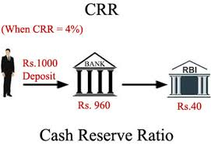
6. As a Controller of Credit
a) Cash Reserve Ratio(CRR) (4%) – Certain percentage of the total bank deposits has to be kept in the current account with RBI. Bank can’t lend the money to corporates or individuals. Banks don’t earn anything on that.

Slide 12
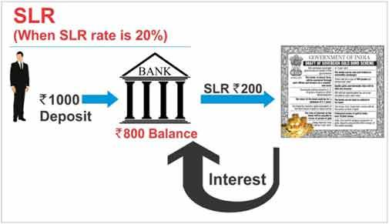
b) Statutory Liquidity Ratio(SLR) (19.5%) – It is the amount of money that is invested in certain specified securities of central and state government.
c) Selective Credit Control
purpose of advances
Margins to be maintained
Maximum amount of advances
Rate of Interest

Slide 13
d) Bank Rate Policy - Bank rate (6.75%) is the rate charged by the RBI for funds to commercial banks
e) Liquidity Adjustment facility
Repo rate(6.25%) – It is the rate at which the RBI lends money to commercial banks in the event of any shortfalls of funds.
Reverse repo rate(6%) – It is the rate of interest offered by RBI on loan taken by it for a short period from the banks.

Slide 14

7. Undertake transactions in foreign exchange
under FEMA(Foreign Exchange Management Act 1999). RBI holds India’s reserves of international currencies and administers the exchange control system in the country.

Slide 15
8. Collection and Furnishing of credit information
power to collect credit information from banks along with the prescribed fee.

